Slide 1
Reproducible Model Development, Rapid Deployment, and the ‘Workmanship of Certainty’
Jake Knight
Hydrologist
Arizona Water Science Center

Slide 2
INTRODUCTION
The following presentation contains a worked example of RRR modeling, a sales pitch for scripted model development, and selected advice from lessons learned.
Presentation Outline
The GULF model
Script-based model development
Project team & workflow
Moments of great success
Cautionary tales

Slide 3
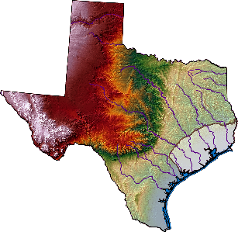
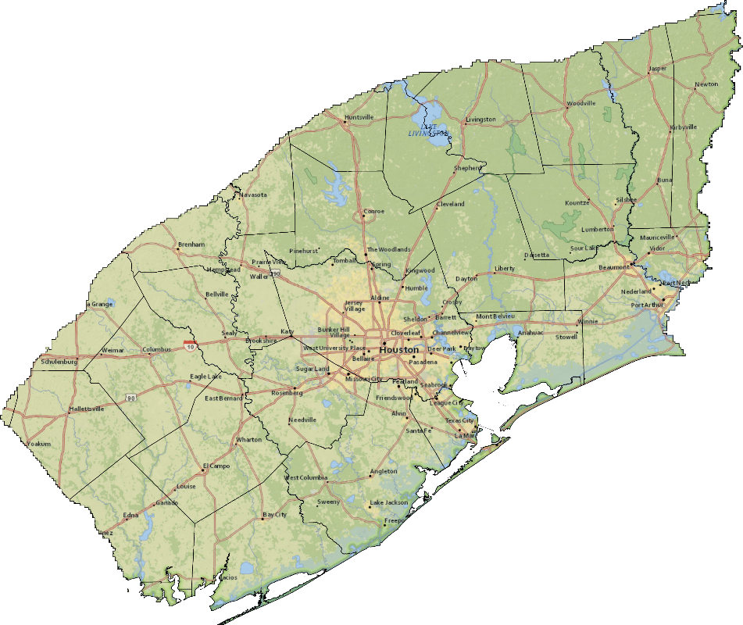
The GULF Model Contentious, Complex, Compressed
Next “Model of Record” for determining allowable groundwater extraction rates in Houston area.
Multi-objective model that must adequately simulate widespread historical groundwater-level declines in multiple aquifer systems, and associated land-surface subsidence
Substantial uncertainty of historical groundwater pumping rates
1st large-scale implementation of CSUB package in MODFLOW 6
Quick turnaround time
Notes:
I worked on the GULF model as the modeling lead from Fall 2019 – Fall 2021
Jeremy White was the uncertainty lead and John Ellis was the project lead. (Core modeling team. Full team at end)
The publication is being shepherded through the review process by project lead John Ellis and will be published this fall.
This was very much a learning experience for me. I was in my 3rd year at USGS and had published 2 simpler models using some scripting and ensemble methods, but nothing to the extent applied in this project.
The next few slides may appear as if the strategy and workflow were predetermined and we knew exactly where we were headed, but in reality we (especially I) learned as we went. I’ll share that perspective with you at the end of the presentation with the happy surprises and lessons learned while we built up this workflow throughout the project.

Slide 4
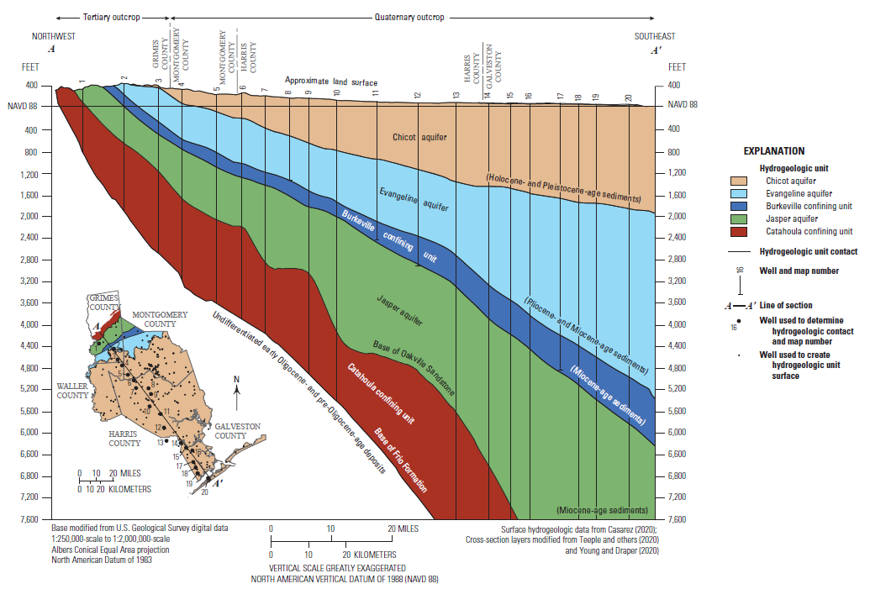
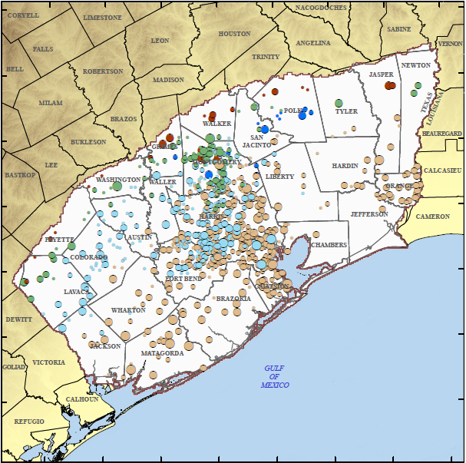
The GULF Model Observation Data – GW Levels
Notes:
Massive amount of historical data in the region. 1897 – 2018
The raw number of gw level measurements was more than 100k. After filtering by location and aligning to model timesteps we ended up with 19k weighted observations of gw levels and an additional 14k derived observations of temporal differences and historical minimums.

Slide 5
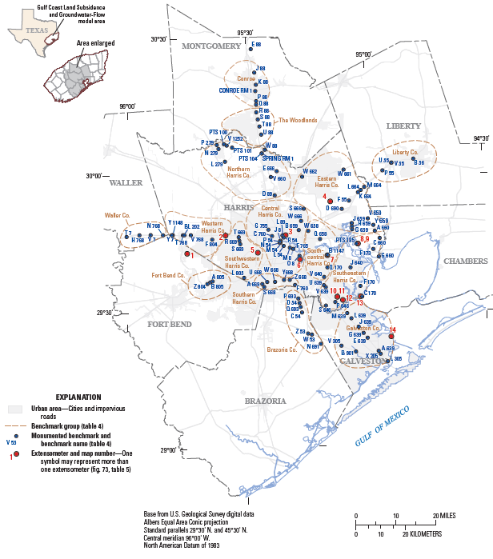
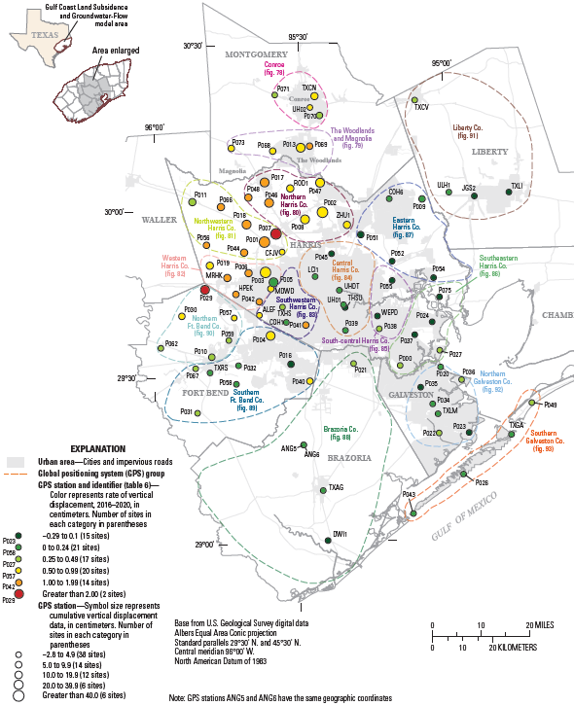
The GULF Model Observation Data - Subsidence
Notes:
We ended up with 19k compaction or subsidence observations and 19k derived temporal difference observations. All totaled we ended up with 71,929 non-zero weighted observations.

Slide 6
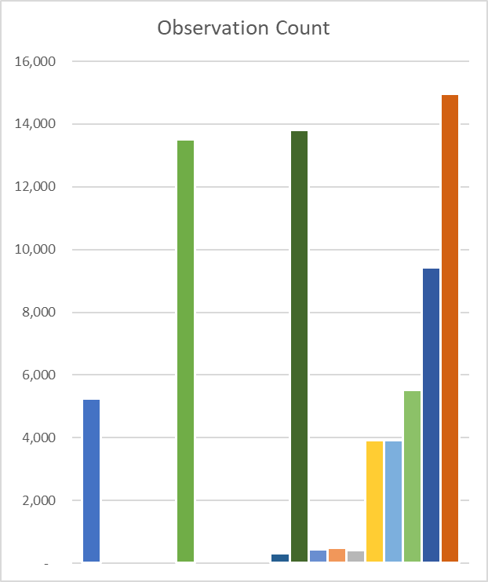
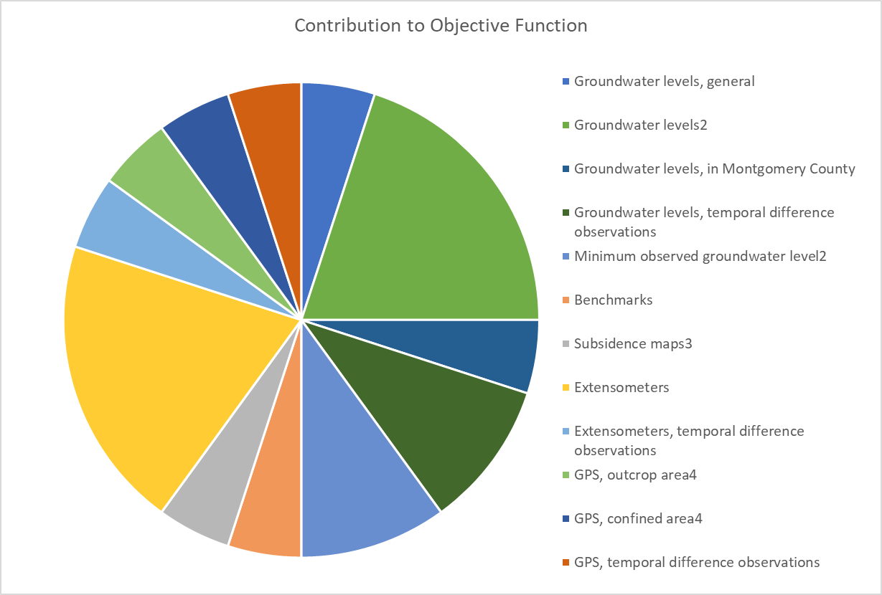
The GULF Model Observation Data
USGS Provisional Data: Subject to Revision
Notes:
Obs weight assignment was one of the most turned knobs in the deployment phase, as we were seeking to satisfy multiple, sometimes contradictory, objectives.

Slide 7
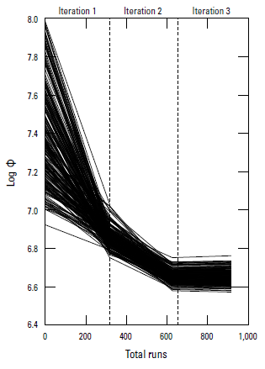
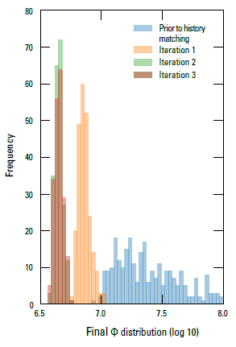
The GULF Model Modeling Strategy
Ensemble approach to parameter estimation and uncertainty quantification. (PEST++ iES)
Draw model realizations from purposefully-wide prior parameter distributions (all multipliers)
Define likelihood function with percent contribution to initial phi by observation group
Judge posterior ensemble based on ability to bracket important observations (objective) and whether spread of parameters and simulated equivalents retain appropriate levels of uncertainty (subjective)
In general: Over-parameterize and under-fit
USGS Provisional Data: Subject to Revision
Notes:
Ensemble method made sense for this project given it was a large complex model that will later be used for many different types of future condition forecasts.
We wanted to maintain an appropriate level of uncertainty in the parameters reflecting our uncertainty in the aquifer properties or forcing inputs. These flow through to the forecasts.
A robust way to maintain your uncertainty in parameters is to use lots of lots of them on different spatial and temporal scales, and fix the distribution or monitor it as it upgrades
Ensemble breaks the dependence of model run count on number of adjustable parameters 183,207 pars, 600 prior runs, ~ 200-300 posterior runs per upgrade iteration

Slide 8
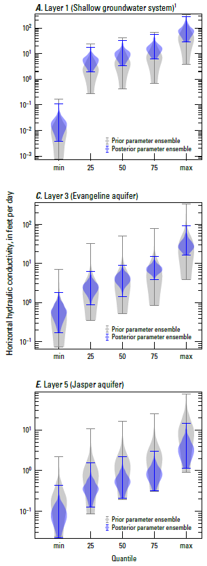
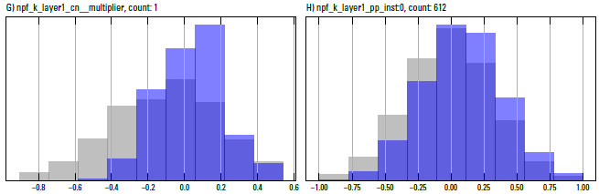
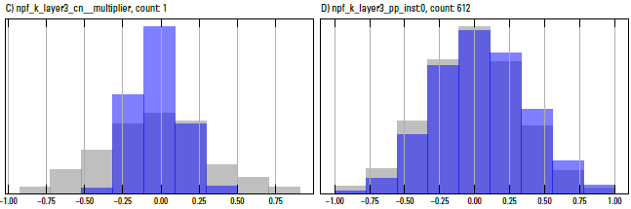
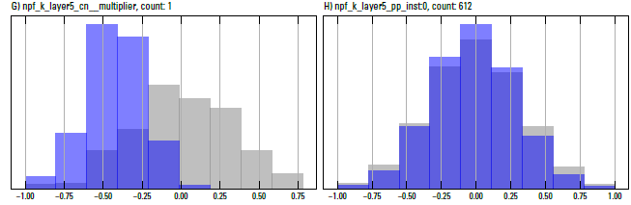
The GULF Model Parameter Distributions
Domain Scale Multiplier
Pilot Point Multipliers
Domain Scale Multiplier
Pilot Point Multipliers
Domain Scale Multiplier
Pilot Point Multipliers
USGS Provisional Data: Subject to Revision
Notes:
Wide prior (gray) – if you can’t catch the obs with a wide net you won’t with a smaller net, unless your parameters twist into knots
1 global and 612 pilot points for most spatially distributed properties
Multipliers are convenient, important to keep track of the effective simulated values

Slide 9
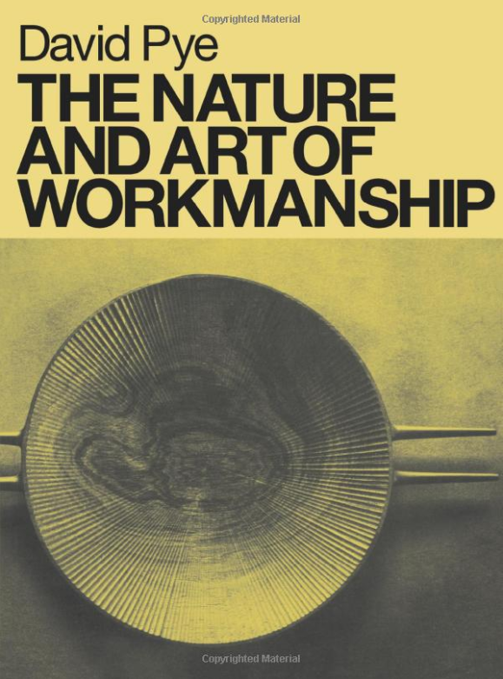
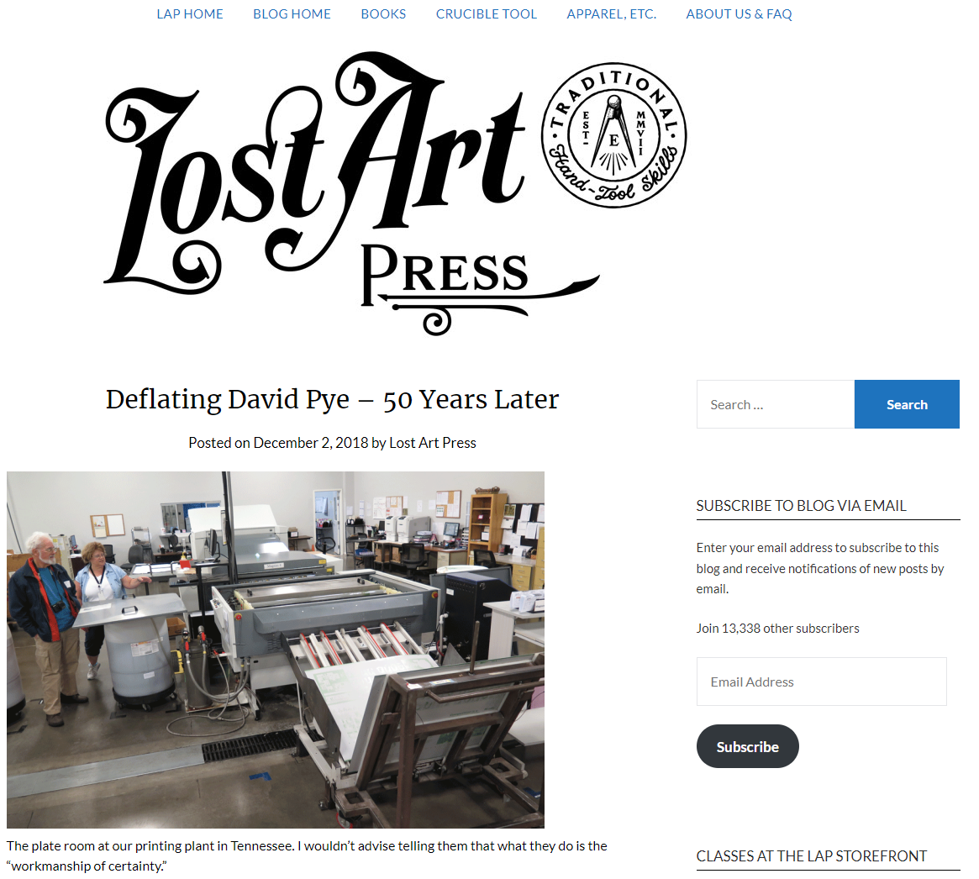
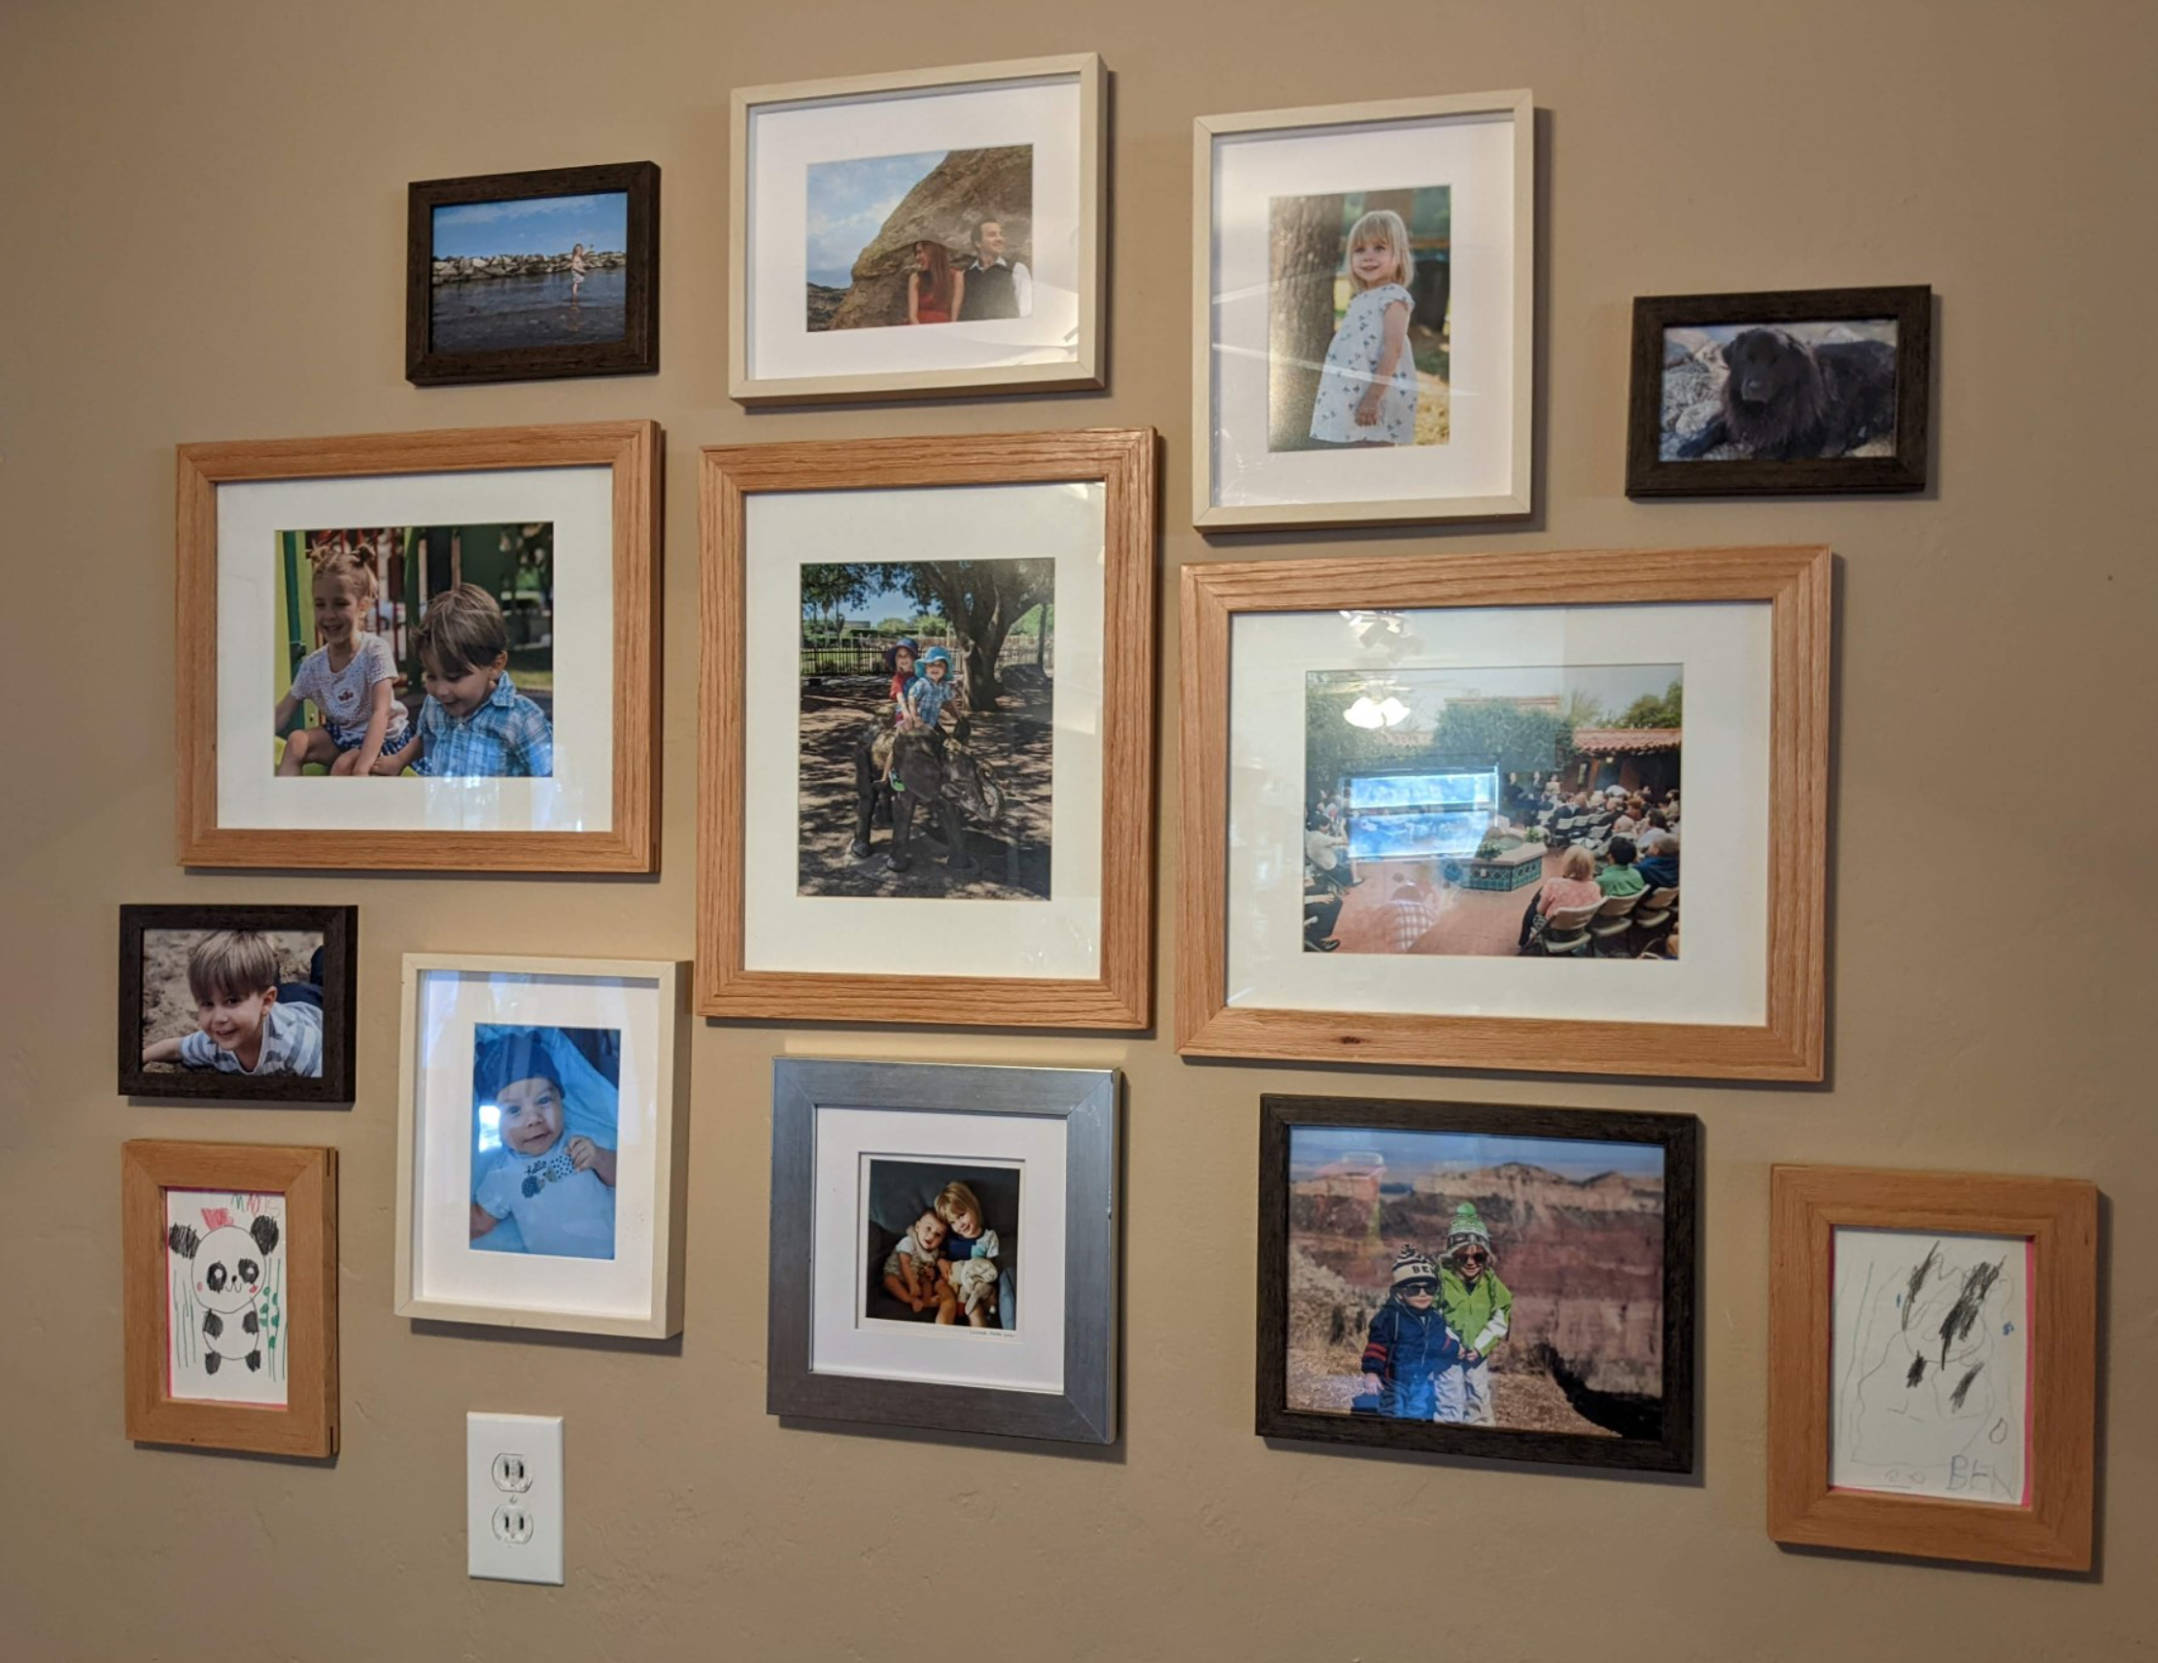
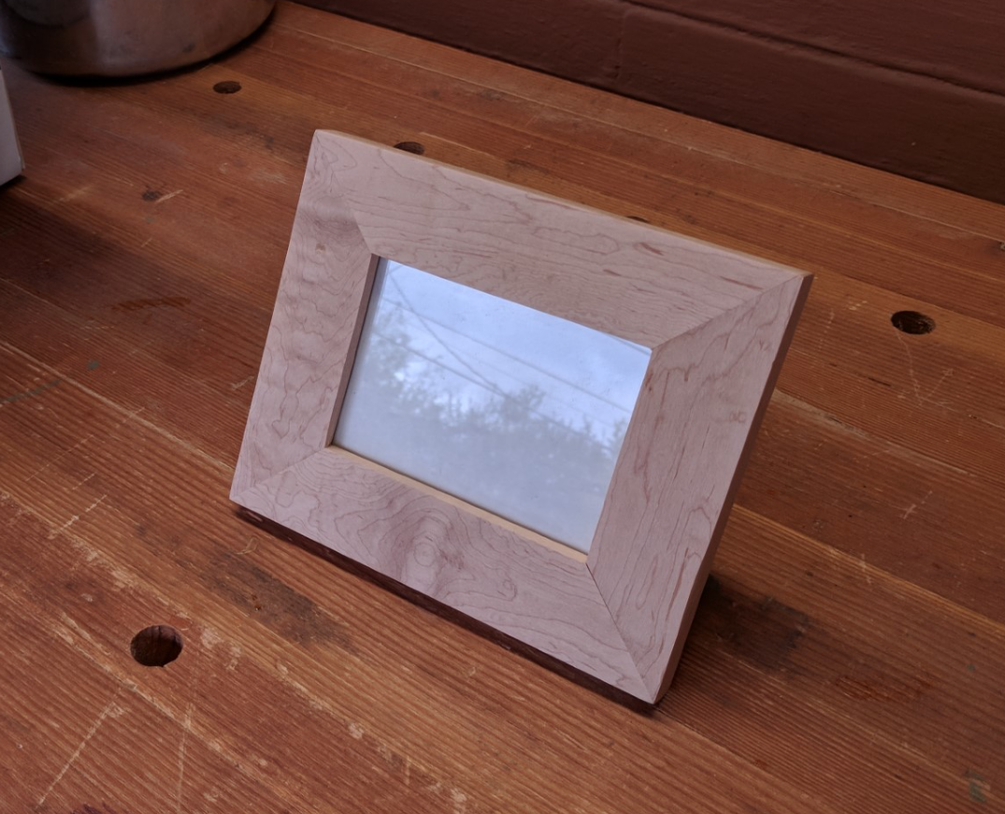
Script-based model development Risk vs. Certainty
From “The Nature and Art of Workmanship” - David Pye (1968)
The most typical and familiar example of the workmanship of risk is writing with a pen, and of the workmanship of certainty, modern printing…
…But all this judgment, dexterity and care has been concentrated and stored up before the actual printing starts. Once it does start, the stored up capital is drawn on and the newspapers come pouring out in an absolutely predetermined form with no possibility of variation between them…
Notes:
7 years ago I got really into woodworking. I started with a purist mindset using only hand tools. Picture frames were especially challenging. I gradually acquired power tools and built jigs to make repeatable cuts. Last year I batched out 20 frames in the time it took me to make 2 or 3 by hand. I traded certain amount of risk (of outcome, not safety) for a certain amount of certainty in production. My hand made frames wouldn’t win any awards but making them felt more artistic, more human. The machine assisted frames look just as good, and by tweaking the process of production I could make them better and faster.

Slide 10

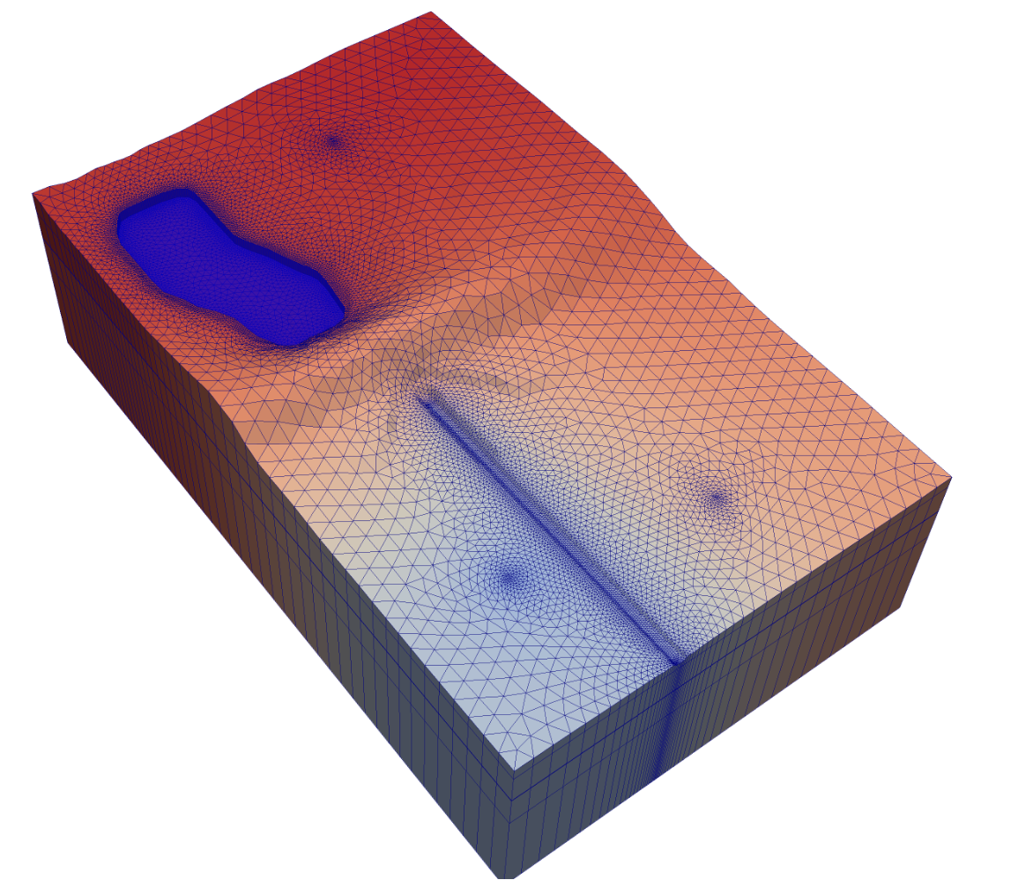



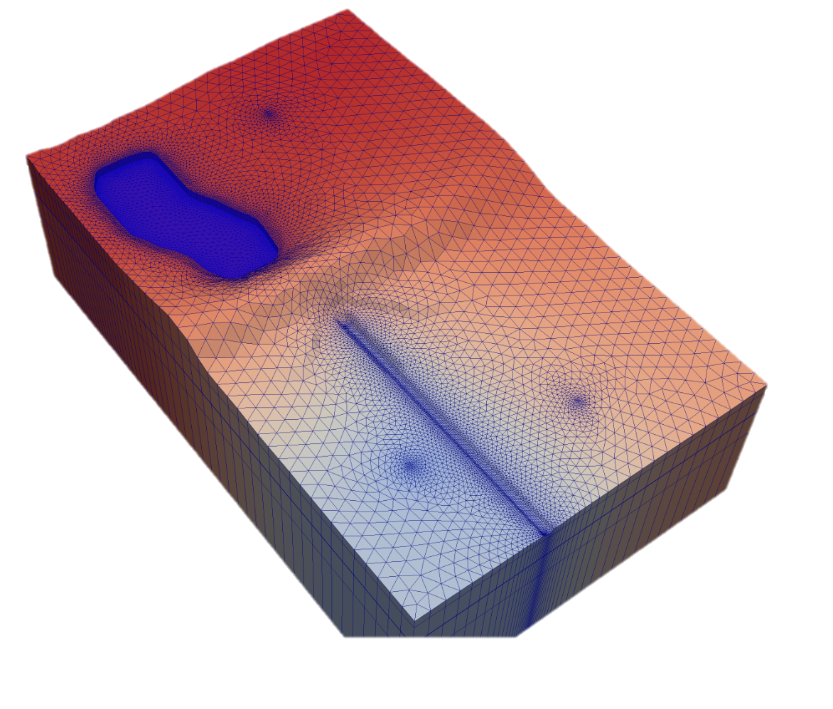
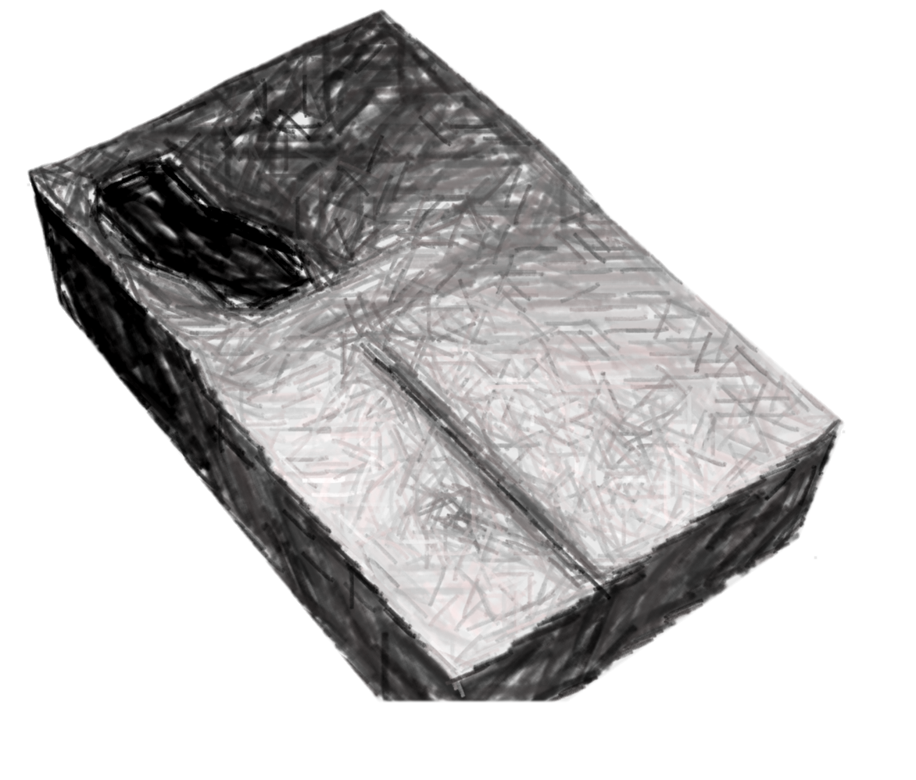
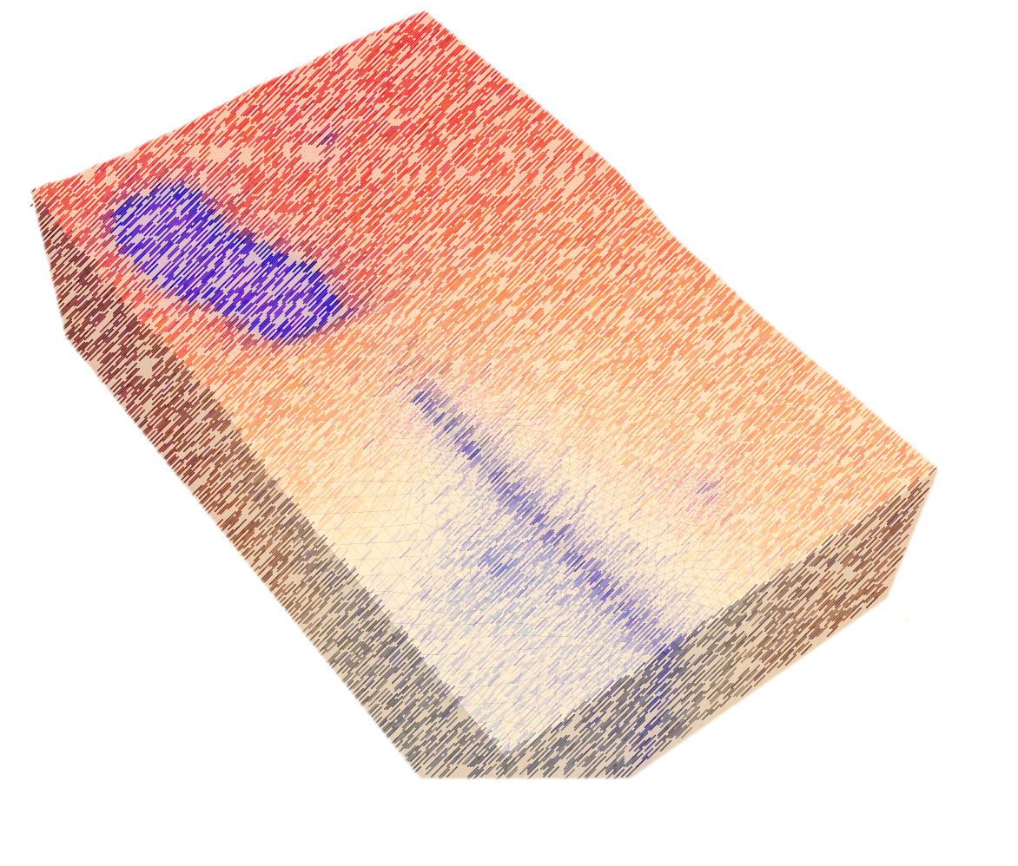
Script-based model development Don’t build a model, build a model factory.
Leverage scripts to “concentrate and store up” your modeling “judgement, dexterity, and care.”
ex: Assertion statements to protect
ex: If/Then statements to adapt
ex: Sample from the Stack Overflow buffet
Reduce your cognitive load (J.White) through automation of all routine tasks. As the project progresses script functionality will grow substantially.
Get off the factory floor and be the CEO of your project. Think deeply! Strategize!
Notes:
We think of our models sometimes as works of art, at least to us. In some ways they are: “Behold the strategic abstractionism in this turn of the century MF2K piece. When contemporaries were flocking to the realism of greater vertical discretization via the HUF package this hydrologist boldly embraced the neo-classic simplicity of the LPF package”
Of course we should take pride our work and the models we produce. But there is no tangible reward for taking unnecessary risk, and no artisanal markup. Stakeholders generally aren’t as beguiled by the creative aspects of our work and just want a number to make a decision. Good job if you can convince them to consider a range of numbers.
How do we provide the best numbers supported by observational data and expert intuition, representing an appropriate range of uncertainty?

Slide 11
Script-based model development Don’t build a model, build a model factory.
Automated reproducibility of models and outputs makes iterative development feasible.
Ignore the waterfall Gantt chart in your project proposal and write code to produce a “minimally viable product” as early as possible.
Plan-Do-Check-Act Cycle (Deming)
Strive for constant improvement of the model (maybe?) and the script (definitely!) through regular iteration.
Notes:
Even if you only built and deployed one model, there would still be value in scripting the process: transparency and reproducibility for verification or a future application.
But where scripted development pays large dividends is the capability to rapidly reproduce model builds and deployments.
When a new model can be produced by modifying a few lines of code and pressing go, we split our risk into small pieces and increase the certainty by developing iteratively.
Minimally viable can mean many things, early on it might be the simplest possible model that runs smoothly and quickly, later on it becomes the simplest version you would be willing to hand over to the client.

Slide 12
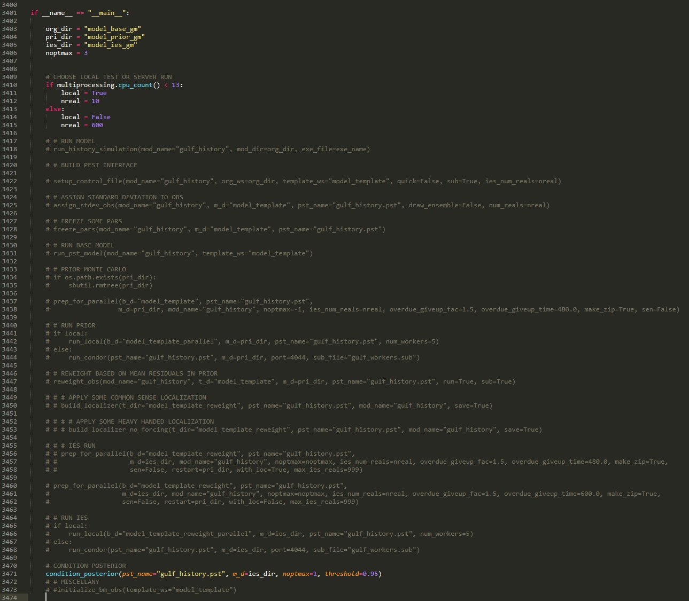
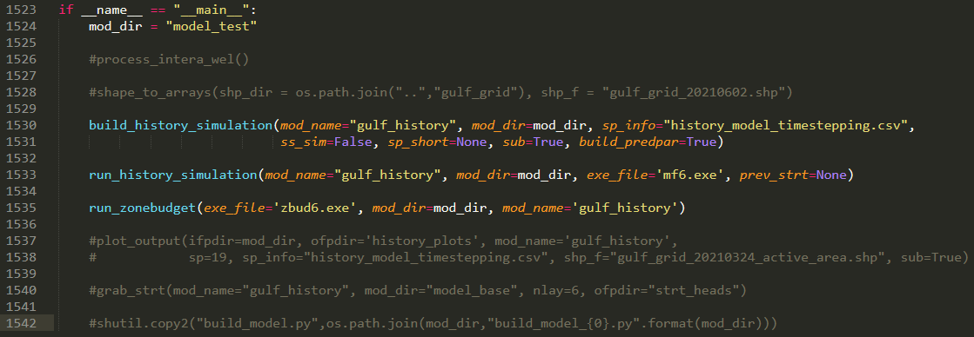
The GULF Model Project Workflow
./model_files/build_pst.py
Plan-Do-Check-Act Cycle (Scrum-“ish”)
Build or deploy a model/ensemble variation by modifying and executing scripts build_model.py and/or build_pst.py
./model_files/build_model.py
Notes:
I hadn’t read a book on Scrum until after this project. In retrospect we hewed pretty closely to this idea of a PDCA cycle.
We sort of fell into the habit of the iterative improvement workflow. Nobody demanded at the outset that we follow this plan (but I absolutely demanded it on my next project).
It followed naturally from the rapid turnaround time made possible by my improving scripts.
Midway through the project we were checking and acting on a new model build or deployment every 2-4 weeks. A lot of that lag time was me adding functionality or processing new data or troubleshooting bugs
By the end of the project we were iterating twice weekly. The scripts were fine tuned enough that changes became easier to make with less likelihood of coding failure.
The bulk of the modeling work was attacked with 3 main scripts: build_model, build_pst, and plot_results.
Each is a collection of functions of which all or some can be executed when the script is called.
At first I would iterate through base model builds focused on stability and getting in the ballpark.
Later the build_pst script became the focus as I would try a series of deployments on a given base model. Sometimes when progress slowed on the deployments the issue was solved by revisiting the base model.
Within the deployment phase sometimes we would run a series of priors trying different levels of parameter complexity or adjustable ranges. (first several functions)
Other times we would create a series of posterior ensembles based on a given prior, changing things like obs group weights or lambda multipliers and scale factors (last several functions)

Slide 13
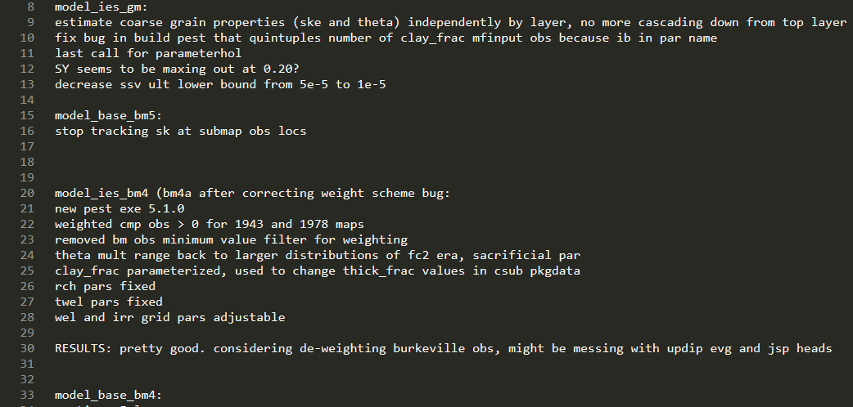
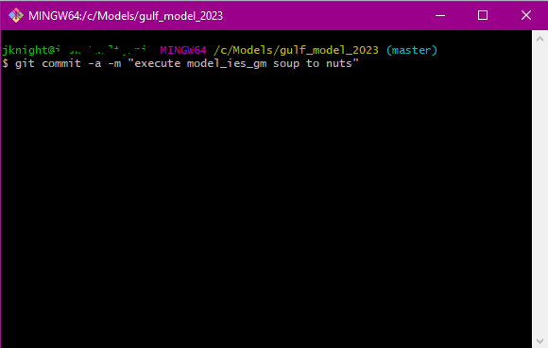
./model_files/gulf_ies_run_notes.txt
The GULF Model Project Workflow
Plan-Do-Check-Act Cycle (Scrum-“ish”)
Build or deploy a model/ensemble variation by modifying and executing scripts build_model.py and/or build_pst.py
Document changes and expectations.
Commit changes to GIT repository.
Notes:
Do = press go.
This will come up again in the lessons learned, but a CRITICAL component of the DO phase is documentation. DO better than I did.
Create a full undo by committing the repository exactly as it is when pressing go.

Slide 14
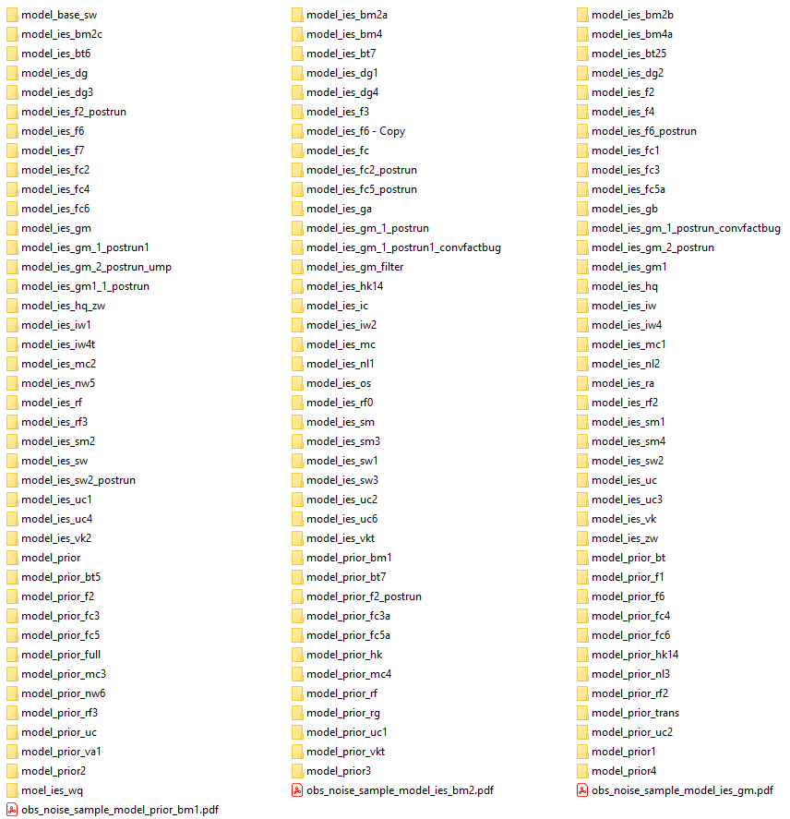
The GULF Model Project Workflow
./model_files/model_plots/
Plan-Do-Check-Act Cycle (Scrum-“ish”)
Build or deploy a model/ensemble variation by modifying and executing scripts build_model.py and/or build_pst.py
Document changes and expectations.
Commit changes to GIT repository.
Review results plot_results.py
Decide next course of action.
Repeat, Repeat, Repeat, until…?
Notes:
Check and Act was a team effort, mostly John Jeremy and I, but sometimes with other project contributors that had needed expertise like subsidence or water use or water level data.
Each iteration plot_results.py produced a folder of outputs that were used to check what we planned and did. Did fit to certain data improve? Did fit to other data degrade? Are we maintaining a healthy posterior spread or did the ensemble collapse? Throughout the project the number of files produced increased from a handful to more than 200.
There was almost always at least 1 obvious next step to act on. Often several possibilities would arise and we would discuss which direction to try next.

Slide 15
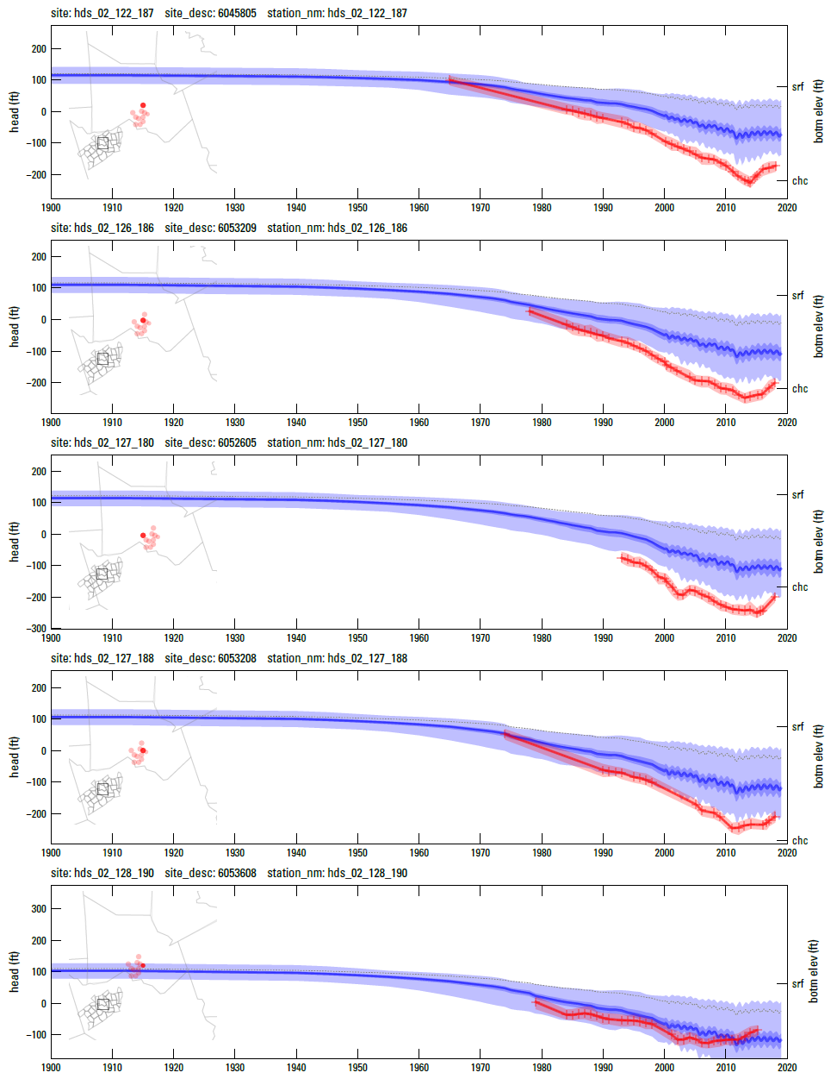
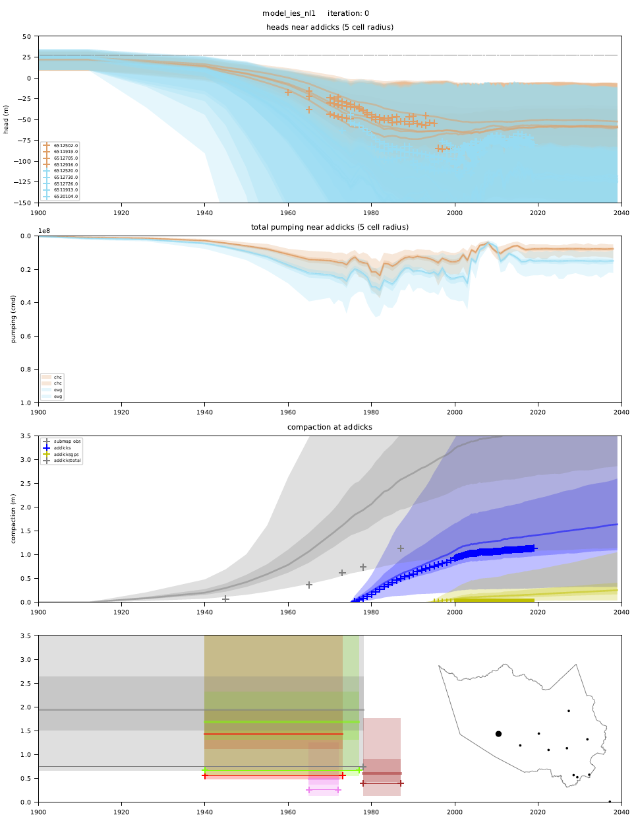
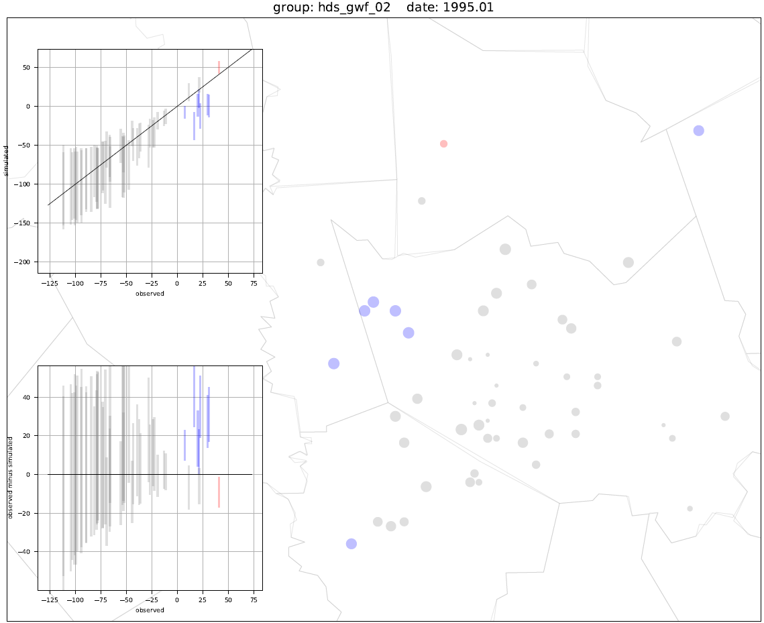
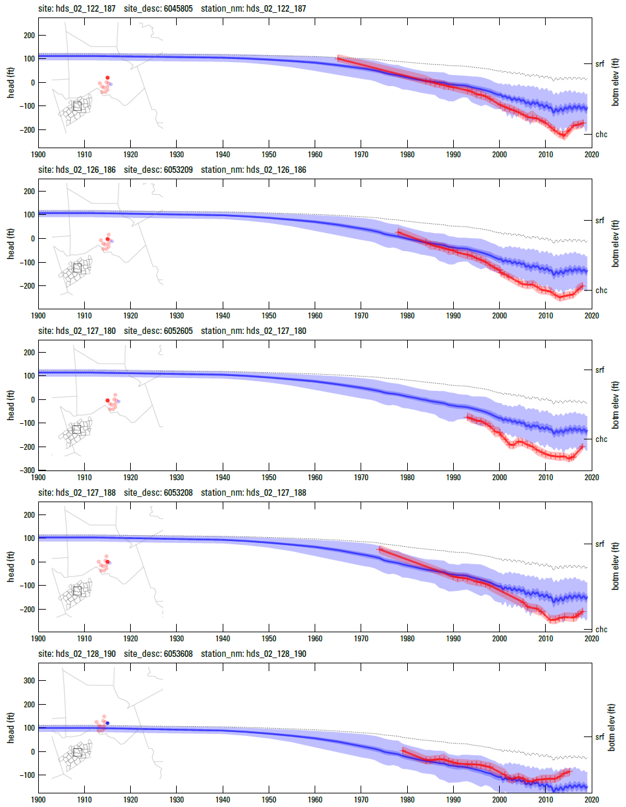
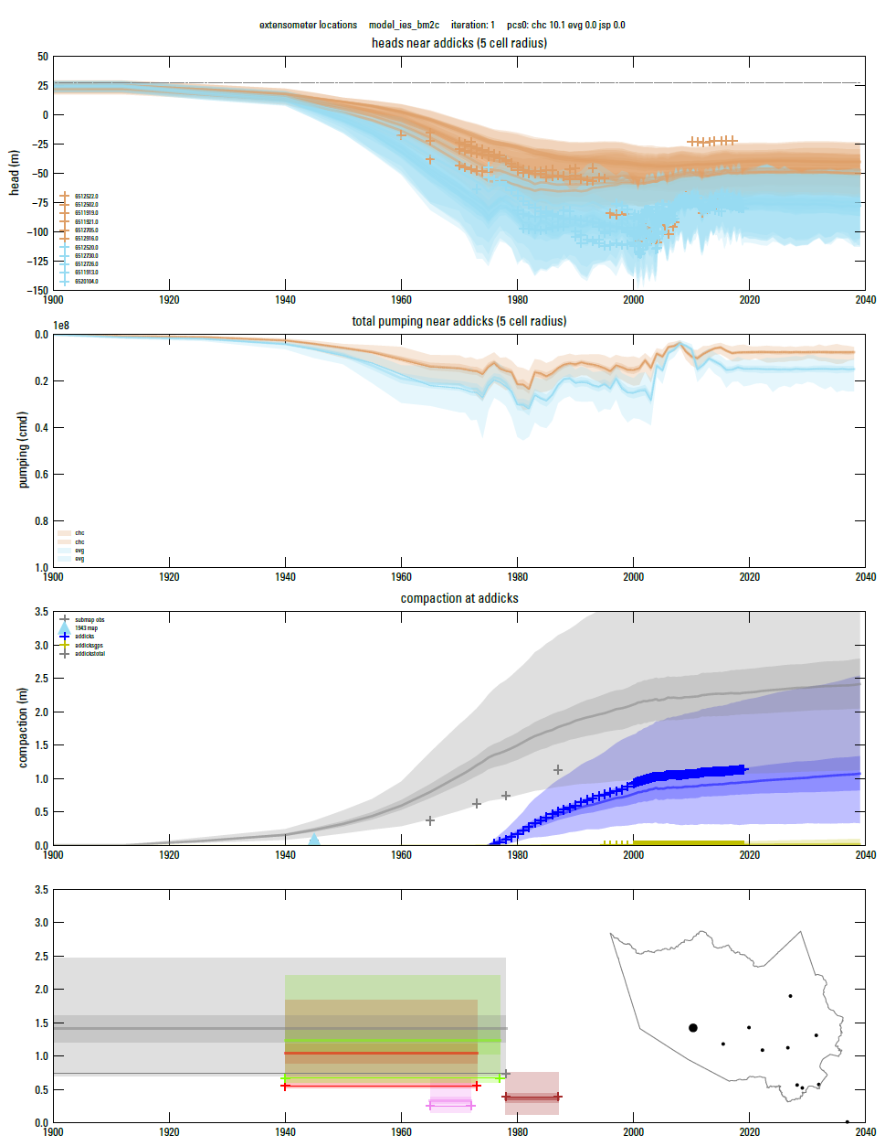
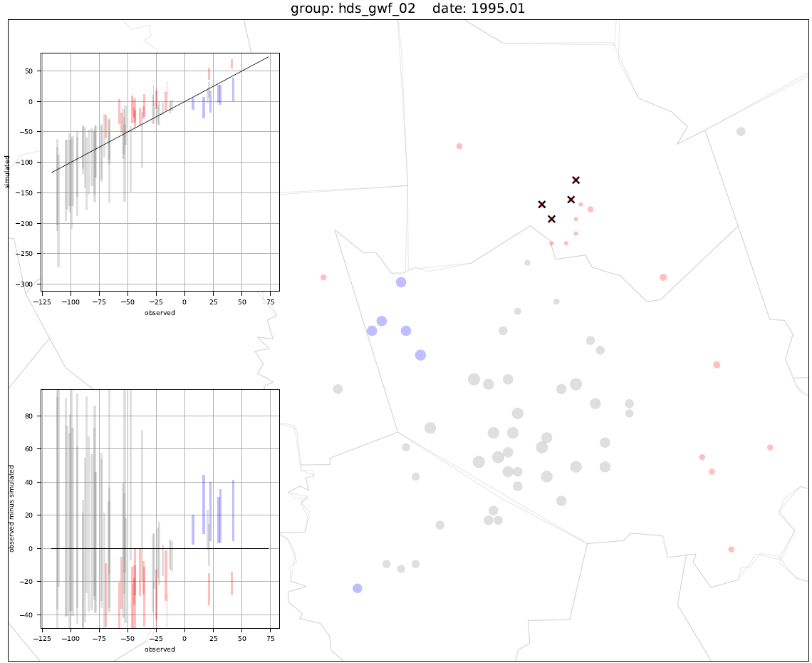
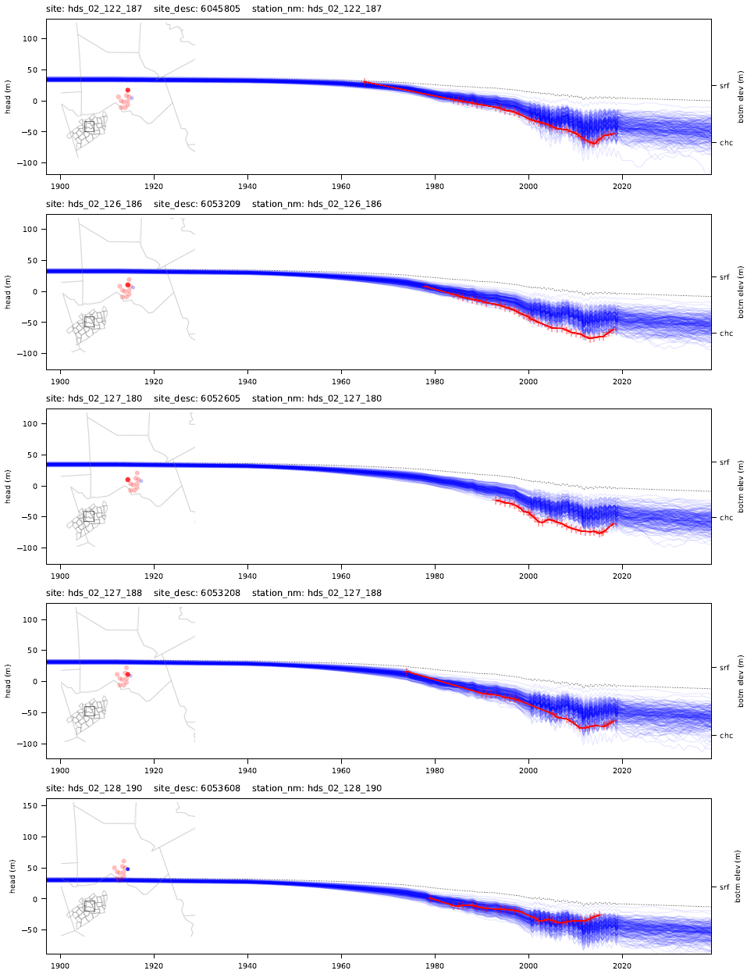
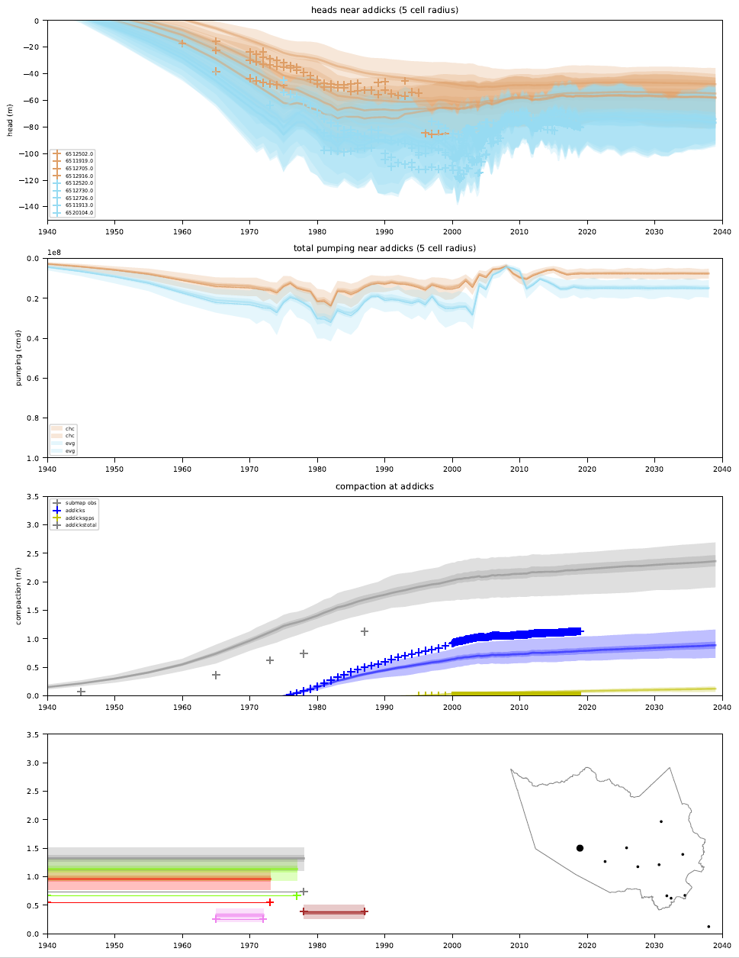
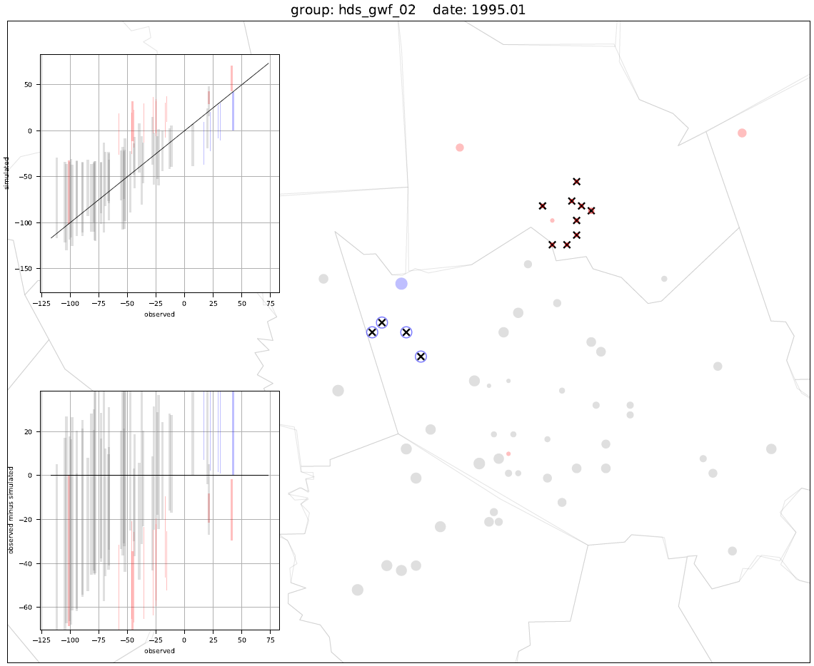
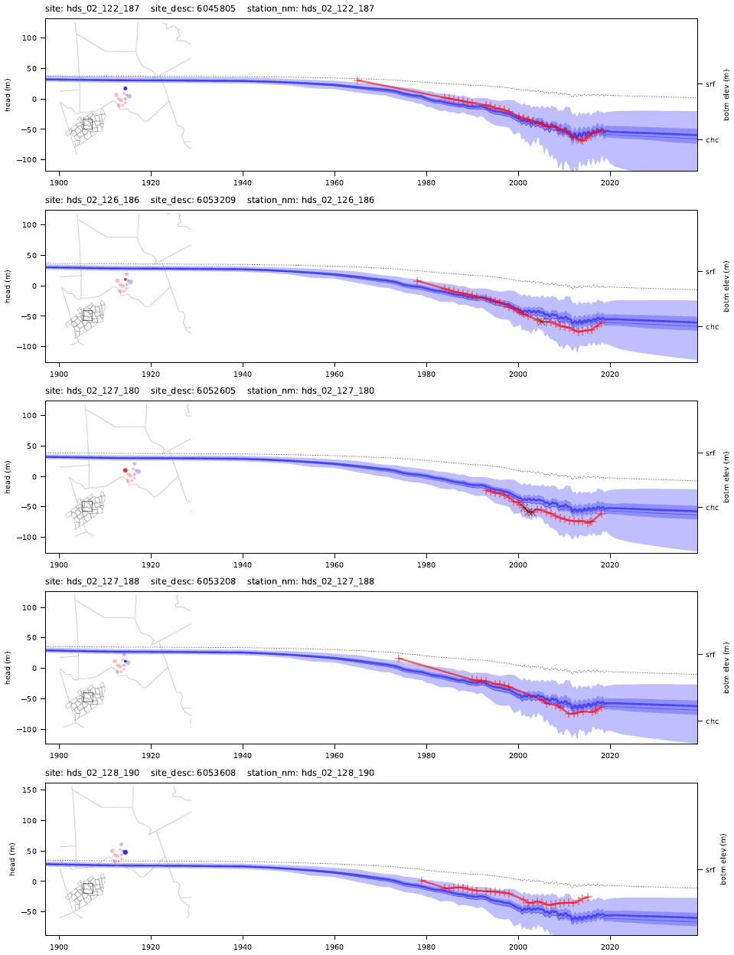
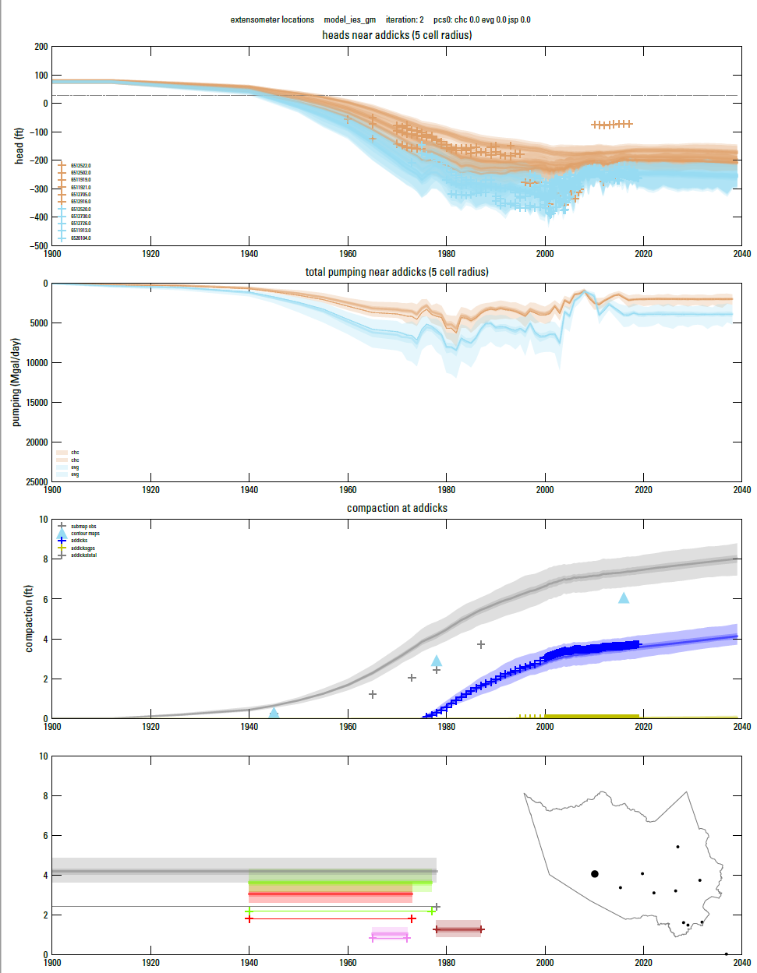
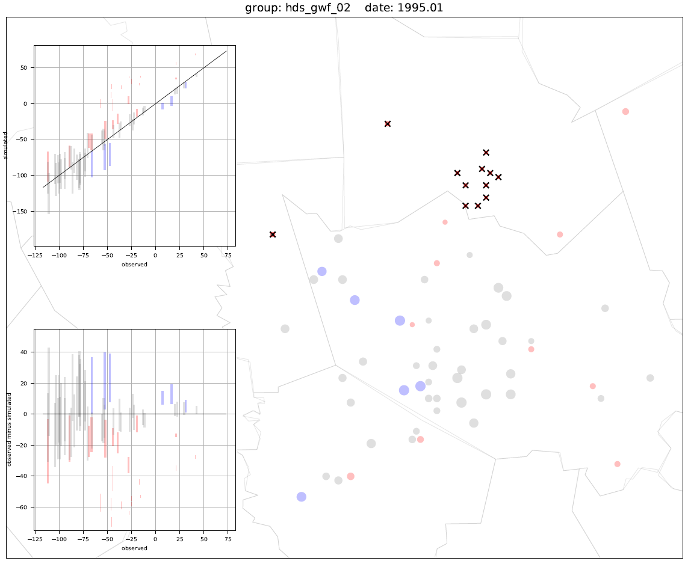
The GULF Model Project Workflow
USGS Provisional Data: Subject to Revision
Notes:
3 sample outputs out of about 200-600 produced per workflow for 4 sample iterations. I didn’t take the time here to select 4 subsequent attempts so don’t read too much into their sequence
Time series on left, spatial snapshot in time on right, integrated water level, water use, subsidence on center
Over time additional features were added to the figures like identifying prior data conflict, color coding high and low misfits, inset maps, multiple related observations and meta-observations.
Some of the improvements were vanity, most were in response to a question raised in a previous act phase of the cycle (what do water use and gw levels look like at this extensometer site? Are we missing high on all the heads in this aquifer or this region?)

Slide 16
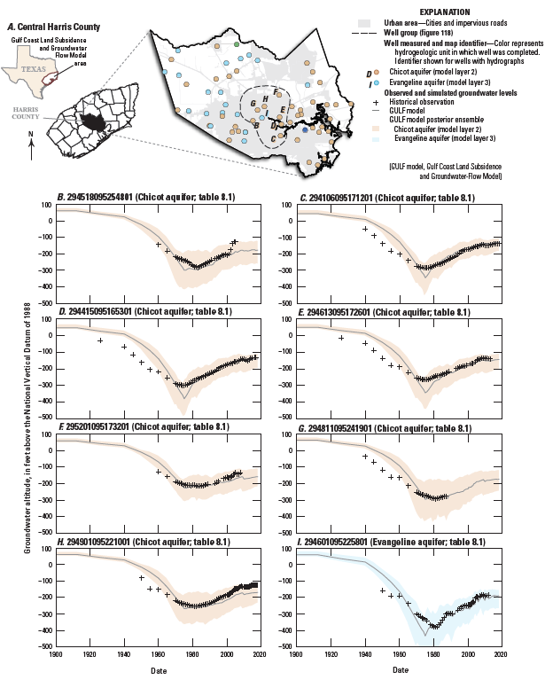
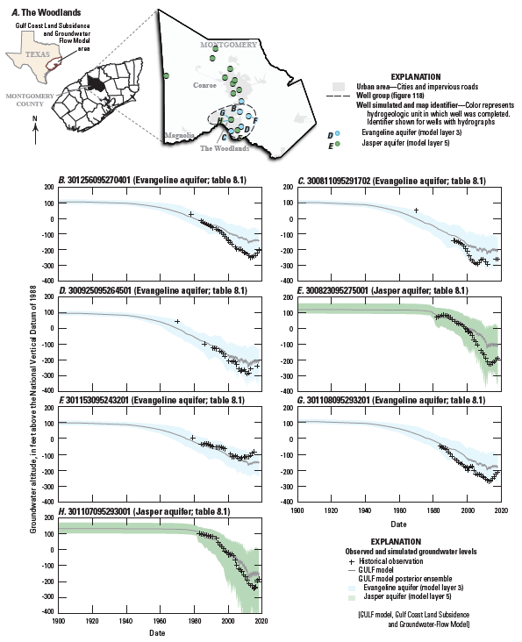
The GULF Model Project Workflow
USGS Provisional Data: Subject to Revision
Notes:
Near the end of the project I worked with John to produce grouped plots exactly the right dimensions to drop into his adobe illustrator templates for report figures.
He was able to start creating the figures before all modeling was complete because any later changes could be swapped in seamlessly

Slide 17
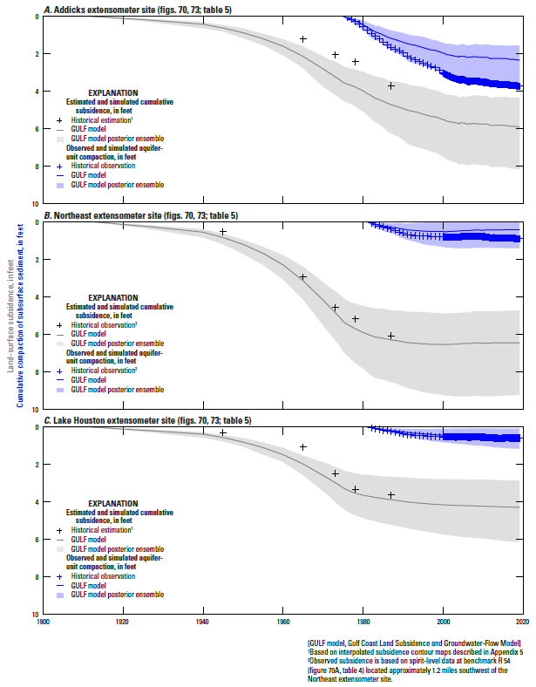
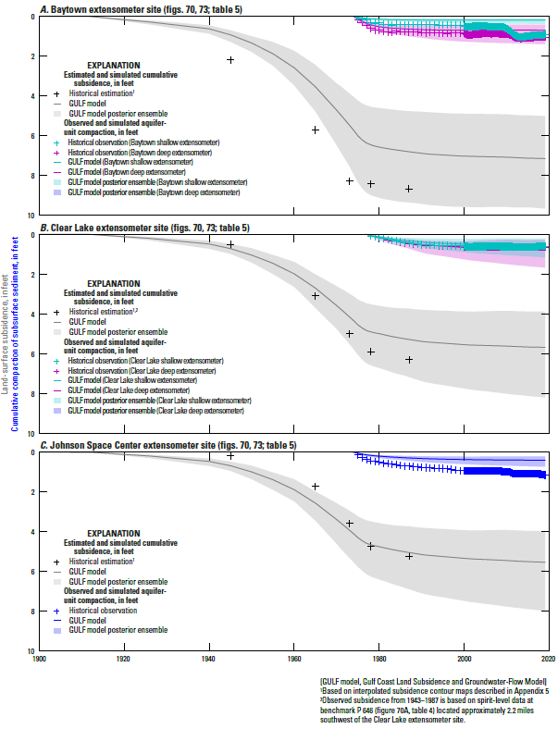
The GULF Model Project Workflow
USGS Provisional Data: Subject to Revision

Slide 18
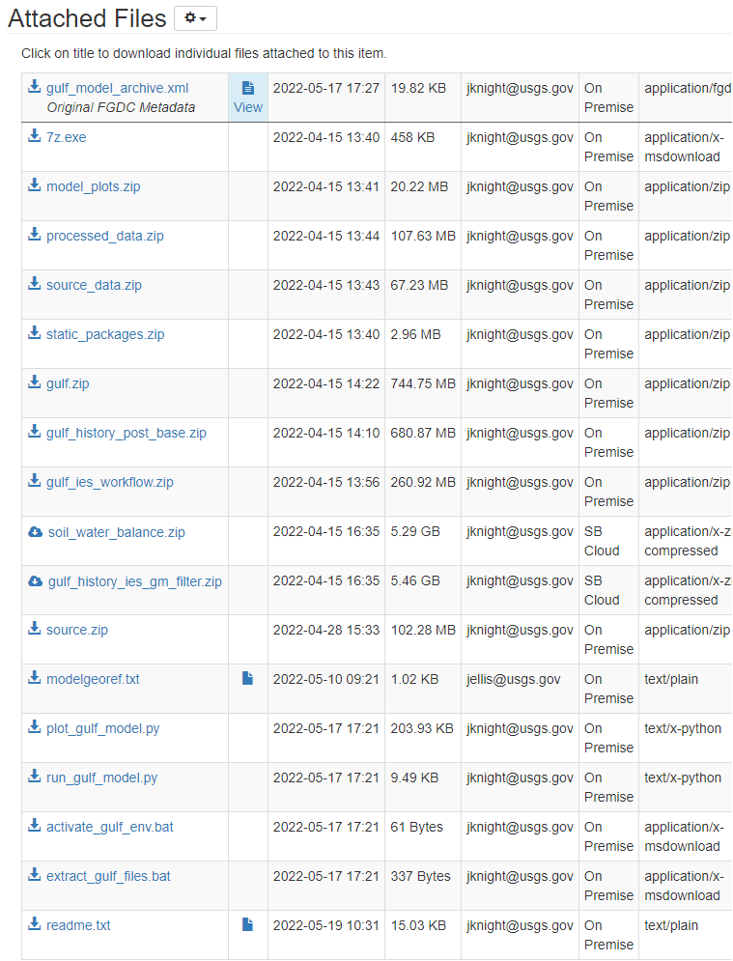
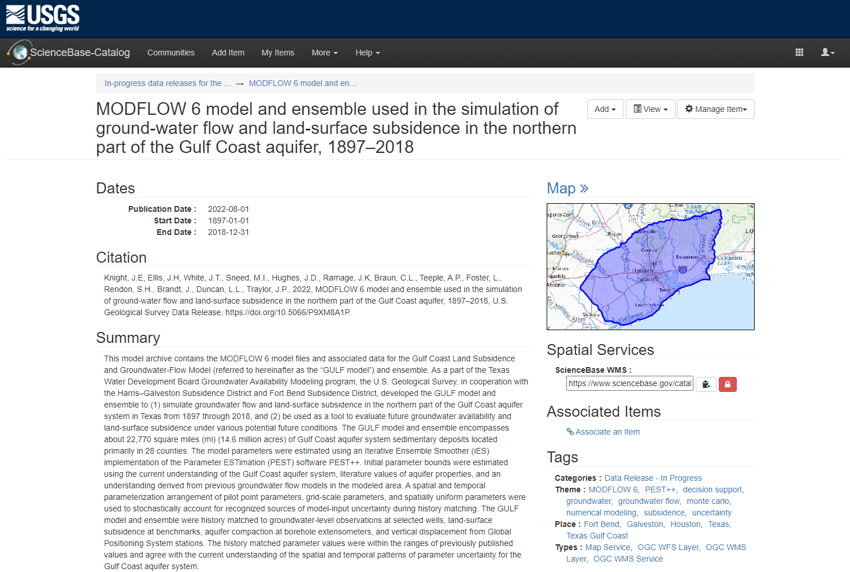
The GULF Model sciencebase.gov (Fall 2022)
Notes:
This fall the model archive data release will coincide with report publication.
You can reproduce the workflow described or sample parts of it for your own project.

Slide 19
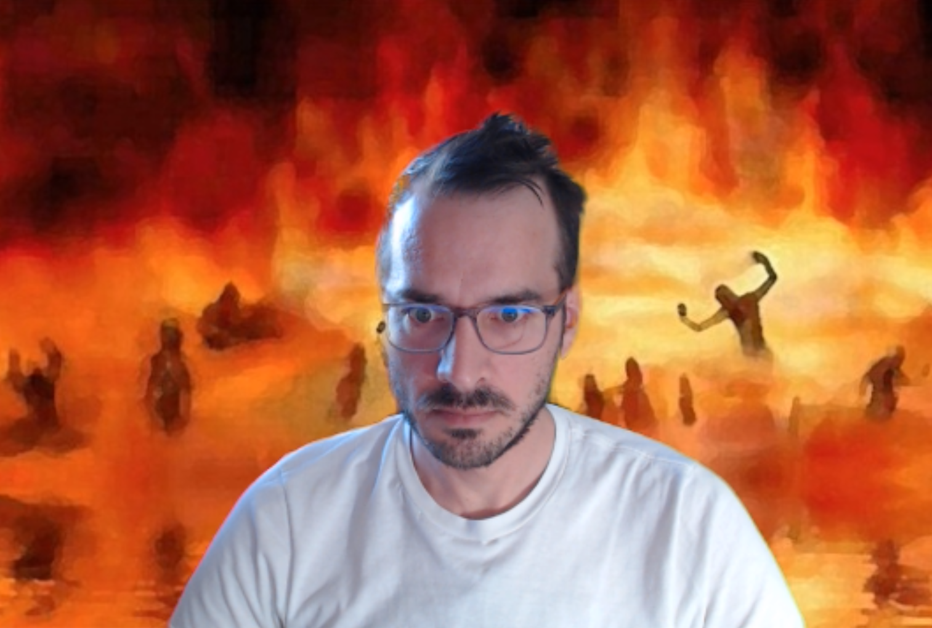
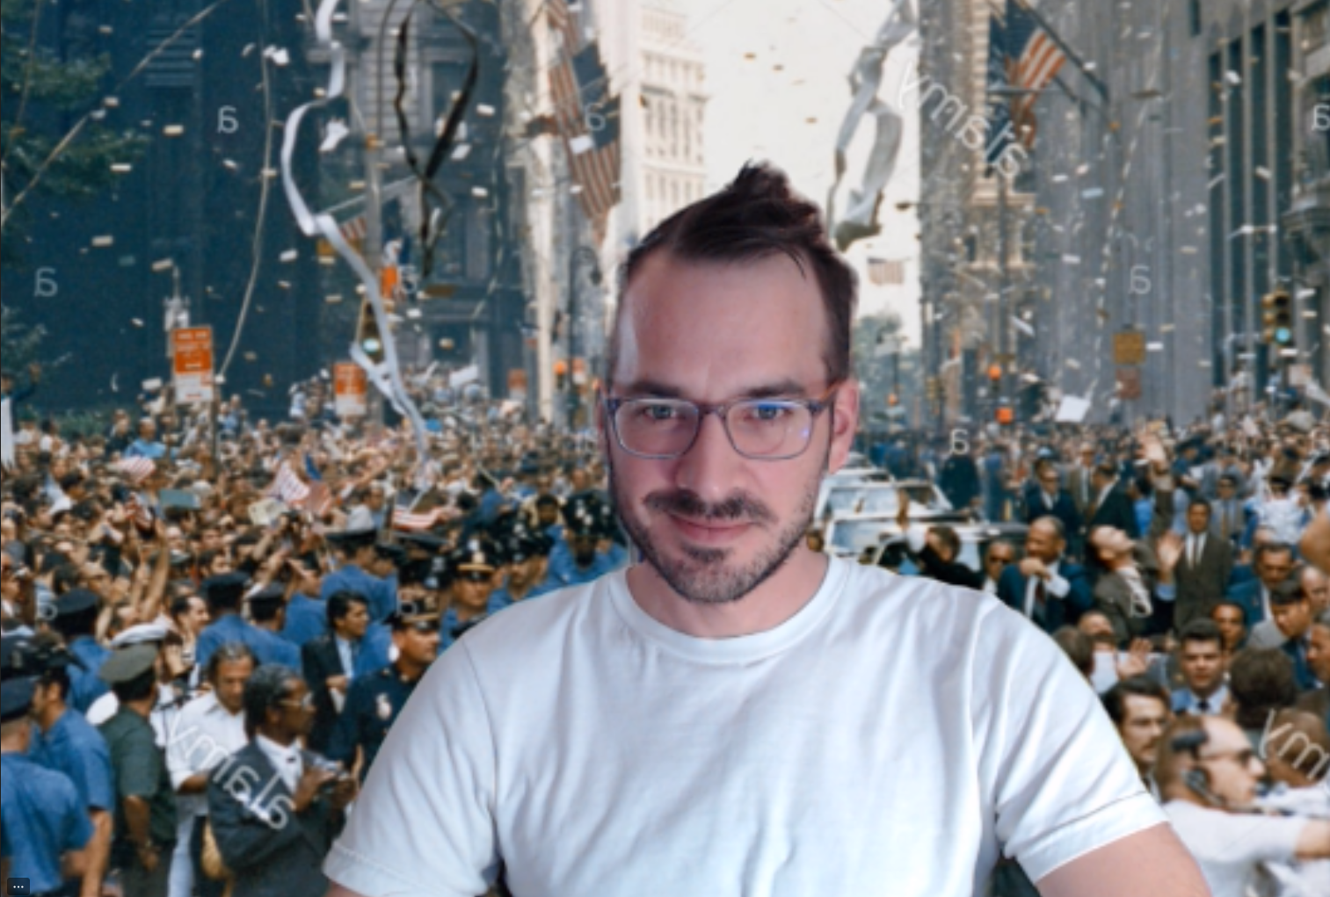
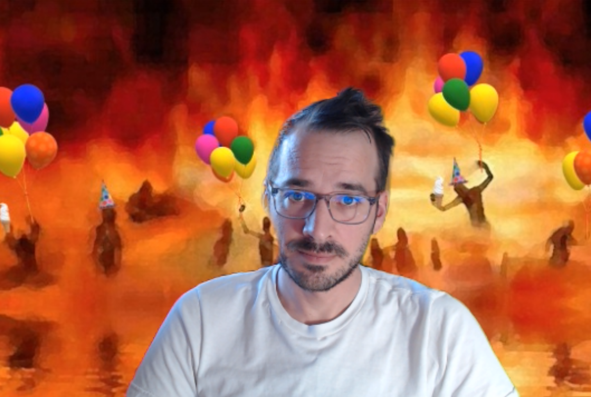
Script-based model development Good for your project, good for your health.
Stochastic Desperation (J White):
something broke, but what?
flailing, try multiple fixes
correlated with planned holidays and project due dates
Steady, incremental improvement:
one success (or failure) at a time
if necessary, UNDO:
$git checkout <commit hash>
python build_pst.py
Notes:
One final pitch for scripted development, this is personal to my experience and maybe many of you as well.
When I heard Jeremy talk about this it resonated with me. I spent a lot of my first 3 years in stochastic desperation.
Working mostly solo day to day as a new modeler I often got stuck and frustrated and without scripted development I did more running in circles.
Combined with encroaching deadlines the stress and anxiety caused by broken model syndrome and their impacts on your physical and mental health can be very real.
This project wasn’t completely without those moments, but there were noticeably fewer.
Part of that was working with a group, and part was reducing the risk, increasing the certainty in each build or deployment by taking a small, quick step instead of a big leap.

Slide 20
Lessons Learned quality of life
Build your TEAM
Group of 2-3 is ideal for most cases.
Avoid going it alone. Recruit a mentor or mentee on a solo project.
Plan regular, SHORT meetings aligned with your PDCA cycle
Budget time/money for “sprint week”
Everyone in same room, neutral city if possible
Most valuable at start, also midway if major shift in project
Keep the next project in mind
More general code = less rework, bigger jump-start
Annotate liberally and include doc strings
Notes:
Paired programming
Sprint week is another scrum-ish thing. Another project aspect I push strongly for now.
Pay your future self some time to focus on interesting research angles or newer modeling techniques

Slide 21
Lessons Learned ensemble strategies
Parameterize Everything
Multi-scale spatial and temporal multipliers
Freeze/unfreeze to retain uncertainty or improve fit
Parameterize EVERYTHING
Maintain flexibility in scripts to handle changing inputs like grid geometry, timesteps, directory structure
Observation-ize (?) Everything
Inputs, outputs, runtimes and solver discrepancies, anything that helps you in the “check” phase of the PDCA cycle
Notes:
With the parameter/model run dependence broken, the only functional hindrance of massive parameterization is storage space and build time.
Spend at least part of your project seeing how big you can go and if it makes a meaningful difference for your model.
At one time we topped 3 million parameters in the gulf model, mostly from grid-scale multipliers for every spatial property on top of the existing pilot point and global multipliers.

Slide 22
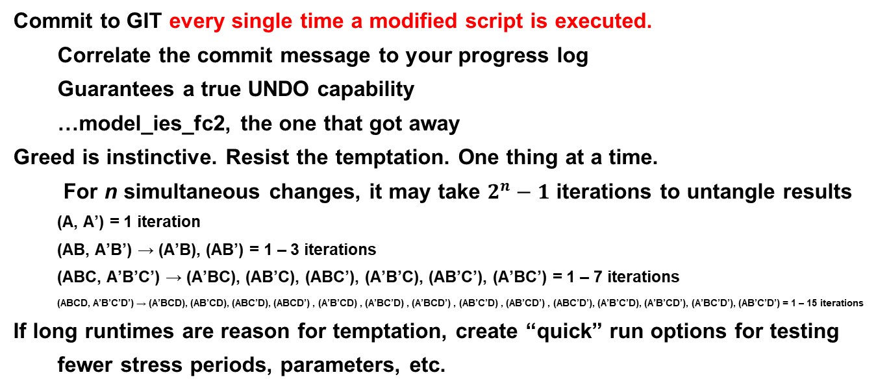
Lessons Learned Cautionary Tales
Commit to GIT every single time a modified script is executed.
Correlate the commit message to your progress log
Guarantees a true UNDO capability
…model_ies_fc2, the one that got away
Greed is instinctive. Resist the temptation. One thing at a time.
For n simultaneous changes, it may take $2^{n}−1$ iterations to untangle results
(A, A’) = 1 iteration
(AB, A’B’) → (A’B), (AB’) = 1 – 3 iterations
(ABC, A’B’C’) → (A’BC), (AB’C), (ABC’), (A’B’C), (AB’C’), (A’BC’) = 1 – 7 iterations
(ABCD, A’B’C’D’) → (A’BCD), (AB’CD), (ABC’D), (ABCD’) , (A’B’CD) , (A’BC’D) , (A’BCD’) , (AB’C’D) , (AB’CD’) , (ABC’D’), (A’B’C’D), (A’B’CD’), (A’BC’D’), (AB’C’D’) = 1 – 15 iterations
If long runtimes are reason for temptation, create “quick” run options for testing
fewer stress periods, parameters, etc.

Slide 23
Lessons Learned Cautionary Tales
There will be errors. Pay yourself some insurance.
Write your “plumbing checks” into the scripts.
Create a project-dedicated Python environment
Start minimally and build as needed
Side-load FloPy and Pyemu to allow for modifications
Use Conda-pack and/or .yaml file for archiving and sharing
GIT track the scripts, not the massive input and output files produced

Slide 24
Lessons Learned ideas for next time…
Incorporate all pre-processing steps into the script
Add functionality in post-processing to compare with previous model(s)
Build the repository in the same directory structure as the anticipated archive
Track and maintain additional meta-observations across model iterations
model structure, runtime, stability, software versions used
ensemble size and success rate
parameter complexity and adjustability by group
observation influence on likelihood function by group
generalized performance metrics like fit to actual data, posterior variance
GitLab Runners? Other automated approaches?

Slide 25
Thank you!
GULF Team:
John H. Ellis,¹ Jacob E. Knight,¹ Jeremy T. White², Michelle I. Sneed¹, Joseph D. Hughes¹, Jason K. Ramage¹, Christopher L. Braun¹, Andrew Teeple¹, Linzy Foster¹, Samuel H. Rendon¹, Justin Brandt¹
¹U.S. Geological Survey
²Intera Geoscience and Engineering Solutions
Email me: jknight@usgs.gov

